Slide 1
Fundamentals of Machine Learning
Lecture 4

Slide 2
Aside
Groups

Slide 3
Topics
Forms of machine learning beyond classification and regression
Formal evaluation procedures for machine-learning models
Preparing data for deep learning
Feature engineering
Tackling overfitting
The universal workflow for approaching machine- learning problems

Slide 4
Branches of Machine Learning
Supervised Learning: Input data to known targets
Classification
Regression
Sequence generation
Syntax tree prediction
Object detection
Image segmentation
Unsupervised Learning: No targets
Dimensionality reduction
Clustering
Self-supervised Learning: No human annotated labels
Autoencoders
Next frame, next word…
Reinforcement Learning: Agent receives information about environment

Slide 5
Evaluating ML Models
Training
Validation
Hyperparameters: Choosing layers and nodes
Overfitting
Information leak
Test
Approaches
Hold-out sample
K-Fold cross-validation
Iterated K-fold crossvalidation with shuffling

Slide 6
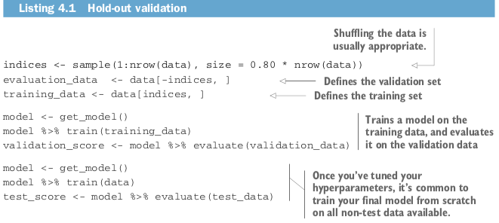
Hold-Out Validation

Slide 7
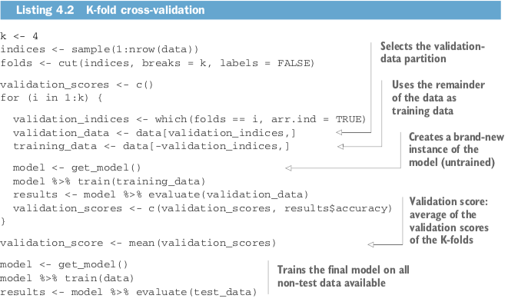
K-Fold Crossvalidation

Slide 8
Iterated K-Fold with Shuffling
It consists of applying K-fold validation multiple times, shuffling the data every time before splitting it K ways. Note that you end up with P x K models, where P is the number of iterations you use.

Slide 9
Things to Remember
Data representativeness
Time
Redundancy of data: Training and validation should be disjoint

Slide 10
Data Preprocessing, Feature Engineering, Feature Learning

Slide 11
Data Preprocessing
Data preprocessing aims to make the data more amenable to neural networks
Vectorization
Normalization
Missing values
Feature extraction

Slide 12
Vectorization
All inputs and targets in a neural network must be tensors of floating-point data (or, in specific cases, tensors of integers).

Slide 13
Normalization
Normalize each feature independently to have a mean of 0 and a standard deviation of 1
Use the scale function in R.
What should you do with the test data?

Slide 14
Missing Data
In NN, it is safe to enter 0 as missing values, unless 0 has meaning. The network will learn that 0 indicates missing.
Remember that test data and training data should both have missing values

Slide 15
Feature Engineering
The process of using one’s own knowledge about the data and the algorithm to ensure that the algorithm works better by applying hardcoded transformation to the data before it goes into the model.
Note: Modern deep learning removes the need for most feature engineering, Does this mean you don’t have to worry about feature engineering as long as you’re using deep neural networks? No, for two reasons:
Good features still allow you to solve problems more elegantly while using fewer resources.
Good features let you solve a problem with far less data.

Slide 16
Overfitting and Underfitting
The fundamental issue in machine learning is the tension between optimization and generalization. Learning to deal with overfitting is essential to mastering machine learning.
Regularization is the process of modulating the quantity of information that a model is allowed to store or to add constraints on what information it’s allowed to store. If a network can only afford to memorize a small number of patterns, the optimization process will force it to focus on the most prominent patterns, which have a better chance of generalizing well.

Slide 17
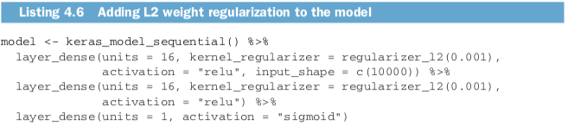
Regularization
Reducing networks size: The more capacity the network has, the more quickly it can model the training data, but the more susceptible it is to overfitting.
Weight Regularization: Occam’s razor
L1: The cost added to the loss function is proportional to the absolute value of the weight coefficients
L2: The cost added to the loss function is proportional to the square of value of the weights coefficients

Slide 18
Dropout
Dropout is one of the most effective and most commonly used regularization techniques for neural networks.
The dropout rate is the fraction of the features that are zeroed out
At test time, no units are dropped out; instead, the layer’s output values are scaled down by a factor equal to the dropout rate, to balance for the fact that more units are active than at training time.
layer_output <- layer_output * sample(0:1, length(layer_output), replace = TRUE)
layer_output <- layer_output * 0.5 (at test time)

Slide 19
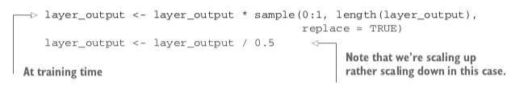
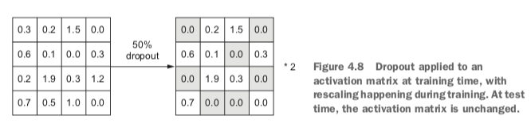
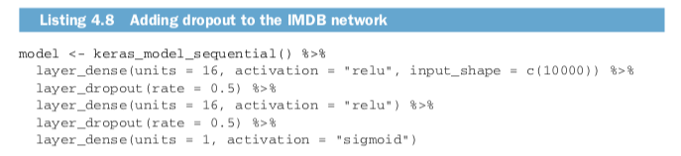

Slide 20
ML Workflow
Define the problem and dataset: What will your input data be? What are you trying to predict? What type of problem? You can only learn to predict something if you have available training data.
Beware: non-stationary problems
Choose a measure of success
Decide on an evaluation protocol
Prepare your data
Develop a model that does better than baseline
Scaling up: Developing a model that overfits
Regularize your model and tune hyperparameters

Slide 21
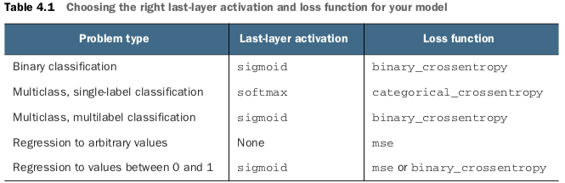
Activation and Loss Functions

